Slide 1






CREDIT CARD FINANCIAL DASHBOARD
ABHISHEK PADHY

Slide 2



PROJECT OVERVIEW
Objective: To develop a robust weekly credit card financial dashboard that delivers real-time, actionable insights into key performance indicators (KPIs) and trends. The dashboard should empower stakeholders to effectively monitor and analyze credit card operations, facilitating data-driven decision-making and optimizing financial performance.

Slide 3
Connecting to SQL Database
1. I downloaded data on credit cards and customers from Kaggle.
2. I thoroughly checked the data in Excel and performed some cleaning and arrangements.
3. I created an SQL database for continuous workflow, as I am doing analysis on a weekly basis for credit card transactions.
4. After creating the database and storing the CSV file in the database, I connected my Power BI with the Post Gre SQL database.

Slide 4
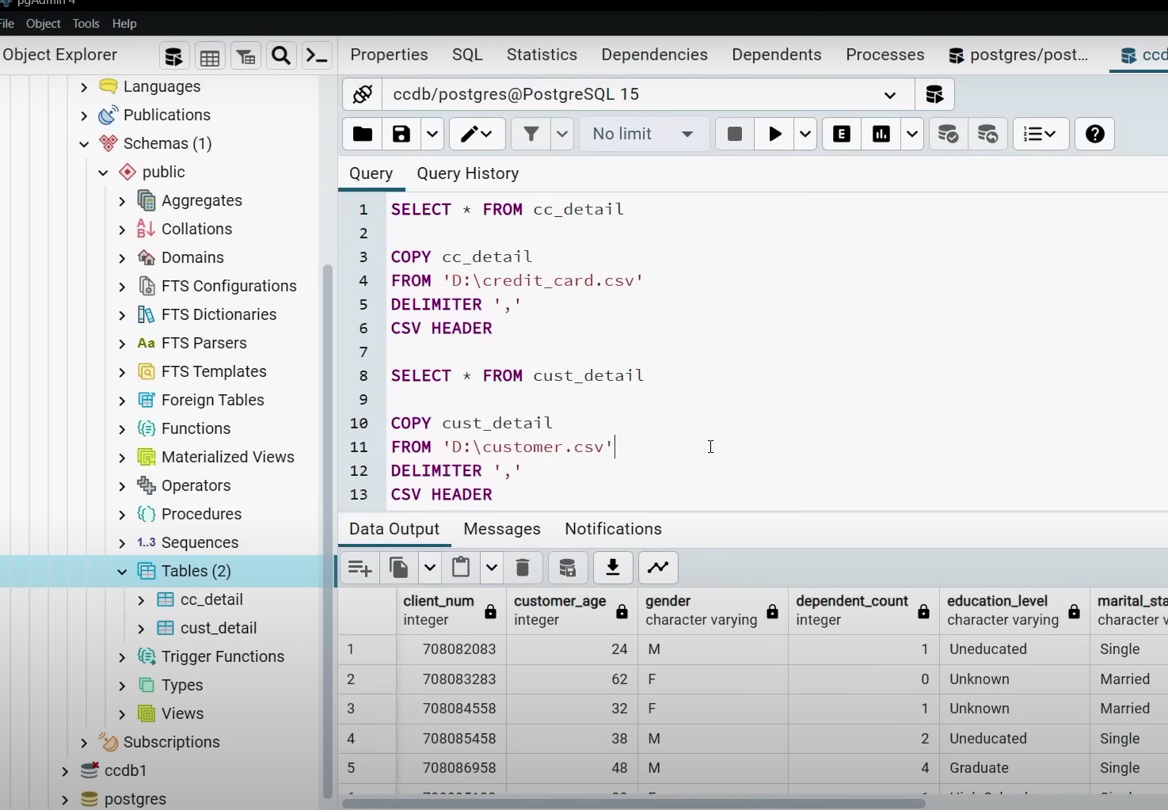
Postgre SQL database

Slide 5
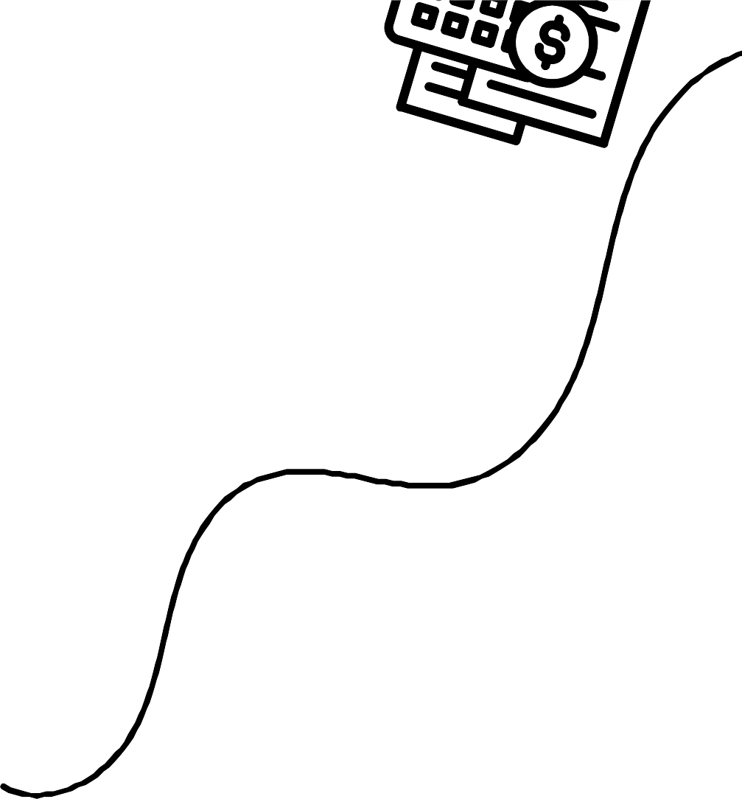


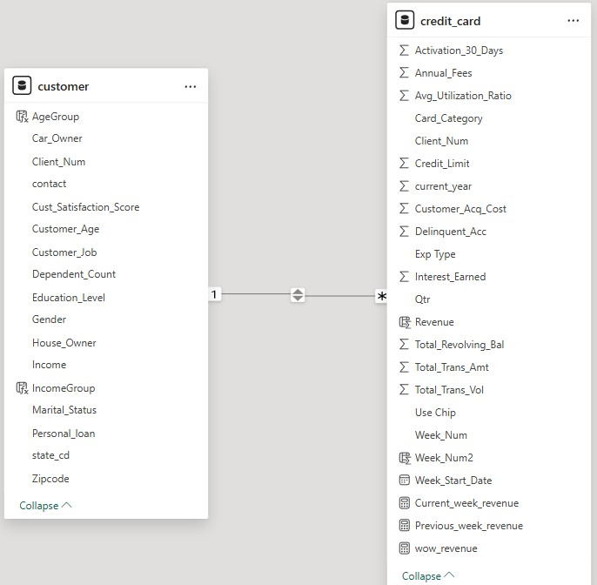
MODEL VIEW

Slide 6

DAX QUERIES
AgeGroup
IncomeGroup
AgeGroup = switch( true(),
'customer'[Customer_Age] <= 30, "18-30",
'customer'[Customer_Age] >30 && 'customer'[Customer_Age] <= 40, "30-40",
'customer'[Customer_Age] >40 && 'customer'[Customer_Age] <= 50, "40-50",
'customer'[Customer_Age] >50 && 'customer'[Customer_Age] <= 60, "50-60",
'customer'[Customer_Age] >60, "60+", "unknown"
IncomeGroup = SWITCH( TRUE(),
'customer'[Income] < 35000, "Low",
'customer'[Income] >= 35000 && 'customer'[Income] < 70000, "Average", 'customer'[Income] >= 70000, "High",
"unknown"
)
)
Week_Num2
Week_Num2 = WEEKNUM(credit_card[Week_Start_Date])

Slide 7


DAX QUERIES
Current_week_revenue
Current_week_revenue = CALCULATE( sum('credit_card'[Revenue]),
FILTER(
all('credit_card'),
'credit_card'[Week_Num2] = MAX('credit_card'[Week_Num2])))
Previous_week_revenue
Previous_week_revenue = CALCULATE( sum('credit_card'[Revenue]),
FILTER(
all('credit_card'),
'credit_card'[Week_Num2] = MAX('credit_card'[Week_Num2])-1))
Revenue
Revenue = credit_card[Annual_Fees] + credit_card[Total_Trans_Amt] + credit_card[Interest_Earned]

Slide 8
Dashboard Highlights
Credit Card Transaction Report
Credit Card Customer Report
Total Transaction Total interest Total debt
Card Type Insights Quarterly Trends
Revenue by Expenditure Type Revenue by Chip Type Education and Job Contribution
Total revenue Average income Total interest earned CSS
Job-based Insights Revenue by Gender Top 5 States Marital Status
Age Group & Income Group Education Level

Slide 9
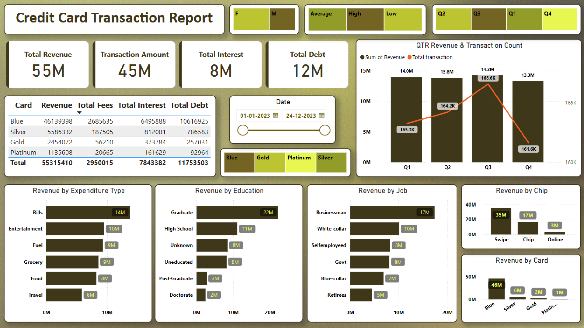

Slide 10
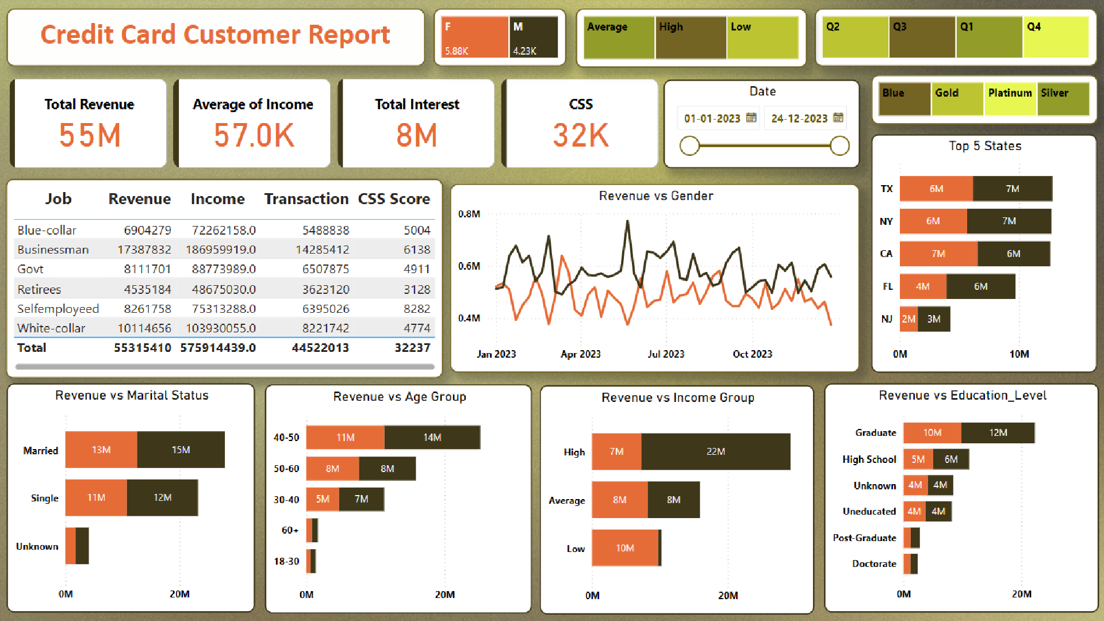

Slide 11
INSIGHTS
I created two dashboards:
1. Credit card transaction report.
2. Credit card customer report.
For the transaction report, I created main KPIs including the sum of total revenue, sum of interest earned from cards, sum of total transaction amount, and sum of total transaction volume.
I also checked which card was performing better and found that the blue card was performing well among all. I also checked the sum of revenue from different factors like education level, job role, gender, expense type, and by chip.
I found that higher education leads to higher revenue, females are creating higher revenue compared to men, and chip swipe transactions generate higher revenue.

Slide 12
INSIGHTS
For the customer credit report, I created a bar chart for the sum of income by job, age group, education level, gender, and state.
I found higher income in business job roles, higher education leads to higher income, and higher age groups have higher income.
While the sum of revenue in a year and days are higher in men compared to women, as shown by a stacked bar chart.

Slide 13
RECOMMENDATIONS
Based on the data analysis:
1. Promote Blue Card: Use promotions to encourage more people to use the successful blue card.
2. Understand customers: Understand customers' demographics (like education and job) to tailor marketing to their needs.
3. Highlight Chip Benefits: Promote the security and convenience of chip transactions to increase their use.
4. Incentivize Female: Offer special deals or rewards to keep female customers engaged, as they currently bring in more revenue.
5. Protect Customer Dat: Ensure strong security measures are in place to safeguard customer information.
6. Stay Updated: Regularly check dashboards to stay on top of trends and make timely adjustments.
7. Listen to Customers: Set up a way for customers to give feedback, helping to improve services and offers.

Slide 14


THANK YOU
ABHISHEK PADHY

